Slide 1
Egad! It’s Excel
Lesson 1.2

Slide 2
A Few Admin Things

Slide 3

Class Repository and Zoom Video Feed
Class Git Repository
Class Videos
Classroom content,
homework assignments
Automatically uploaded,
on-demand videos

Slide 4
Quick Refresher

Slide 5
Data analytics is about what two things?

Slide 6

A
Fundamentally, data analytics is about storytelling and truth-telling.

Slide 7
What are the steps in
the Analytics Paradigm?

Slide 8
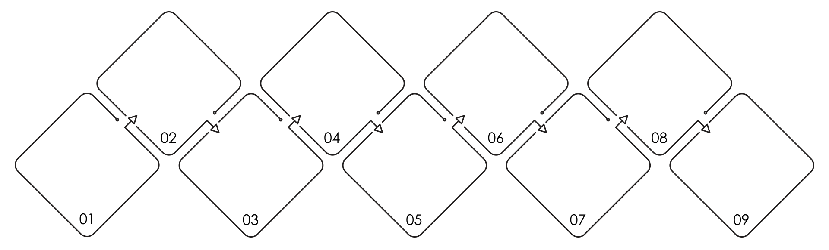
Analytics Paradigm
Regardless of type or industry, this paradigm provides a repeatable pathway for effective data problem solving.
Identify Data Sources
Build Data Retrieval Plan
Assemble and Clean
Acknowledge Limitations
Decompose the Ask
Define Strategy and Metrics
Retrieve the Data
Analyze for Trends
Make the Call or Tell the Story

Slide 9
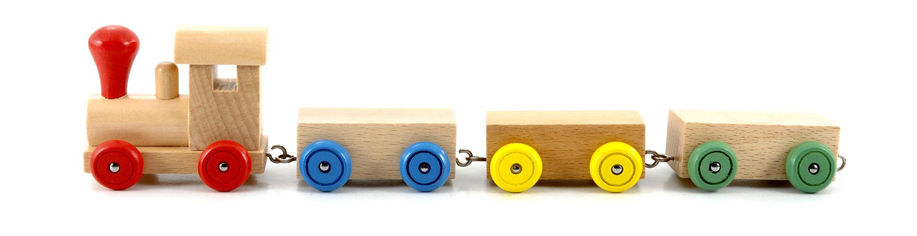
Let’s Start with the Basics

Slide 10
Excel Playground

Slide 11
Excited to get started?!

Slide 12
Formulas

Slide 13
Ooh…Coding! (Sort Of)
Excel has introduced you to a sort of proto-programming. When you write scripts, you will rely on functions (methods) that do something to or with arguments.
= | SUM( | 1, 2, 3 | )
 | Function | Arguments | Function

Slide 14
Ooh…Coding! (Sort Of)
When we reference a range or a set of ranges, Excel is given a set of variable inputs. Excel will determine the actual values of these inputs prior to executing the function.
= | AVG( | F4:F6 | )
 | Function | Variable Arguments | Function

Slide 15

Ooh…Coding! (Sort Of)
Q
What about this example?
Which is the function?
Which are the arguments?
= SUM( AVG(F4:F6), AVG(G4:G6) )

Slide 16
Ooh…Coding! (Sort Of)
Q
A
What about this example?
Which is the function?
Which are the arguments?
The AVG functions take the provided ranges as their arguments.
= SUM( AVG(F4:F6), AVG(G4:G6) )

Slide 17
Ooh…Coding! (Sort Of)
Q
A
What about this example?
Which is the function?
Which are the arguments?
This is a nested function. We’ll be doing plenty of complex nests in this class.
= SUM( AVG(F4:F6), AVG(G4:G6) )

Slide 18

You Can Code Too!
Here’s a Python snippet from the last class.
requests.get(target_url_italian, headers=headers).json() requests.get(target_url_mexican, headers=headers).json()

Slide 19
You Can Code Too!
Syntax and capabilities may differ across technologies and platforms, but fundamental concepts remain the same.
Function
Arguments
requests. requests. | get get | (target_url_italian, headers=headers) (target_url_mexican, headers=headers) | .json .json | () ()
Another Function
(Chained)

Slide 21
Named Ranges

Slide 22
There are multiple ways to select data in a formula
Most of us learned to select a range of cells to input into a function
=AVG(A1:A10)

Slide 23
There are multiple ways to select data in a formula
But we can name a range of values to make interpreting formulas easier!
=AVG(A1:A10)
=AVG(prices)

Slide 25
Color Counter

Slide 26


Conditionals: If This, Then That
Conditionals present a way to control the flow of logic based on certain criteria being met. This is a core building block of all languages.
Step 2a
If criteria is met…
Step 1
If criteria is not met…
Step 2b

Slide 27

Conditionals: If This, Then That
=IF(D2>5,TRUE,FALSE)
If D2 > 5
Set Cell to True
Determine D2’s Value
If D2 <=5
Set Cell to False

Slide 28
But what if we want to combine conditions?

Slide 29
A
AND, NOT, OR

Slide 30
Ooh…Coding! (Sort Of)
Q
A
But what if we want to combine conditions?
AND, NOT, OR
=IF(AND(D2>5, D2<10),TRUE,FALSE)

Slide 31
Conditionals: If This, Then That
Nesting conditionals are powerful, but can become convoluted very quickly!
If D2 > 5 AND D2 < 10
Set Cell to True
Determine D2’s Value
If D2 <=5 OR D2 >= 10
Set Cell to False

Slide 33
Activity: Gradebook
Create a formula that calculates the final grade for a student based on their previous exams and papers.
15 minutes

Slide 34
Activity: Gradebook
To do | Create a formula which calculates the final grade for a student based upon their previous exams and papers.
When making this calculation | Consider every paper and exam to be equal in weight; each should comprise one-fourth of the overall grade. Round the result to the nearest integer. Using conditionals, create a formula that returns PASS if a student’s final grade is greater than or equal to 60. If a student’s final grade is below 60, the formula should return FAIL.
Bonus | Create a nested IF() formula that returns a letter grade based on a student’s final grade. Greater than or equal to 90 = A Greater than or equal to 80 and less than 90 = B Greater than or equal to 70 and less than 80 = C Greater than or equal to 60 and less than 70 = D Anything less than 60 = F

Slide 36
Measures of Central Tendency

Slide 37
What are “measures of central tendency”?

Slide 38
A
Values used to describe the center of a data set.

Slide 39
Central Tendency
Three most common measures of central tendency:
Mean
Median
Mode
The “arithmetic” average
To calculate: The sum of all values, divided by the number of values
The middle value of a data set
To calculate: Sort the data set and find the center
The most frequent value of a data set
To calculate: Count the frequency of each value in a data set, determine the most frequent value

Slide 42
Formatting

Slide 43
Formatting in Excel falls into two categories
Data Formatting
Style Formatting
Changes the way a value is represented in a cell.
Used to help with interpretation or to add context to the range of values
Examples
Date and Time
Currency
Percentage
Scientific Notation
Changes the way the cell and text are viewed
Can include font color, cell highlighting, borders, etc.
Can be performed manually or using formulas/logic (conditional formatting)

Slide 45
Pivot Tables

Slide 46
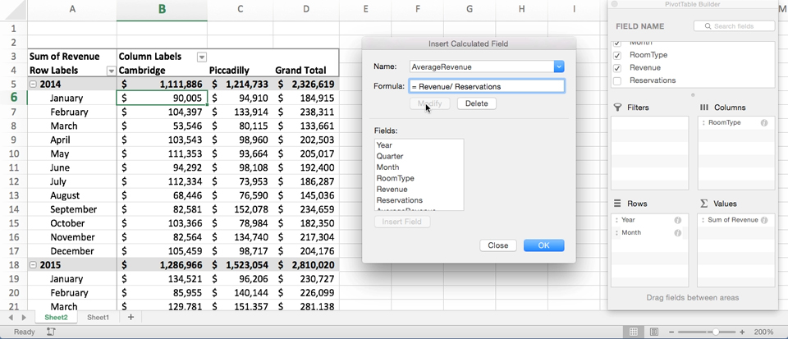
Get Pivot With It
Pivot tables are one of the most important data visualization concepts to master in this class. (Don’t worry. They are a cinch to deal with.)

Slide 47
Get Pivot With It
In essence, a pivot table is a summative analytic tool that allows us to perform aggregate functions that allow any combination of fields. (The term pivot table comes from the fact that we are pivoting along a data axis).
Seller | Qty. Sold | Date
Joseph | $42.50 | 1/1/17
Jacob | $65.00 | 1/3/17
Jacob | $5.25 | 1/6/17
Joseph | $125.00 | 1/6/17
Jacob | $3.50 | 1/7/17
Matt | $32.00 | 1/9/17
Seller | Total Sold
Joseph | $167.50
Jacob | $73.75
Matt | $32.00

Slide 48
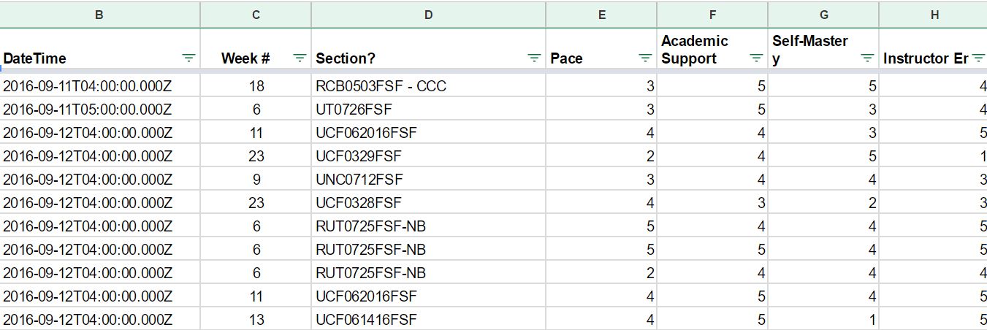
Word to the Wise: Keep It Flat!
Modern Business Intelligence (BI) tools like Tableau, Sisense, and Salesforce work best if data is stored in flat CSVs—meaning column headers represent fields (vertically) on the spreadsheet. This is largely because all of these technologies heavily utilize pivot tables as a tool for their visualizations. Don’t try to confuse this simplicity. “Spreadsheet magic” is a nightmare to analyze.

Slide 50
Activity: Top Songs Pivot Table
In this activity, you will use a 5000 row spreadsheet containing data for the top 5000 songs from 1901 onward. Using pivot tables, you will uncover which artists have the most songs in the top 5000, the song titles, and the year each song was released.
17 minutes

Slide 51
Top Songs Pivot Table Instructions
Select all of the data in your worksheet and create a new pivot table.
Make a pivot table that can be filtered by year and contains two rows: Artist and Name.
All of an artist’s songs should be listed below their name.
Update your pivot table to contain values for:
How many songs an artist has in the top 5000
The sum of the final_score of their songs.
Sort your pivot table by descending sum of the final_score.

Slide 53
Lookups

Slide 54
Look It Up with Lookups
Q
Assume this table is gigantic. How would we retrieve the population of a specific planet for use in another formula?
Planet | Population
Zeelo | 5020
Merinoa | 380
Cardboard Box | 2
… | …
Asteroid 9 | 95

Slide 55
Look It Up with Lookups
Q
Assume this table is gigantic. How would we retrieve the population of a specific planet for use in another formula?
A
=vlookup( <value>, <full table>,
<column to retrieve>,<match parameter>)
Planet | Population
Zeelo | 5020
Merinoa | 380
Cardboard Box | 2
… | …
Asteroid 9 | 95

Slide 56
Look It Up with Lookups
Q
What will this yield?
=vlookup( “Asteroid 9”, Planets, 3, FALSE)
Planet | Population | Species
Zeelo | 5020 | Zoltans
Merinoa | 380 | Murphies
Cardboard Box | 2 | Hambones
… | …
Asteroid 9 | 95 | Asterisks

Slide 57
Look It Up with Lookups
Q
What will this yield?
=vlookup( “Asteroid 9”, Planets, 3, FALSE)
Planet | Population | Species
Zeelo | 5020 | Zoltans
Merinoa | 380 | Murphies
Cardboard Box | 2 | Hambones
… | …
Asteroid 9 | 95 | Asterisks
A

Slide 59
Partner Activity: Product Pivot
An independent artist who sells their designs on products in an online store has called upon the class to create a table which visualizes the cost of their recent orders. Using lookups, create a pivot table which serves this purpose.
15 minutes

Slide 60

Partner Activity: Product Pivot
Determine the "Product Price" of each row in the "Orders" sheet by using a VLOOKUP() that references each row's "Product ID"
The "Product Price" of a row does not include shipping
Determine the "Shipping Price" of each row in the "Orders" sheet by using a VLOOKUP() that references each row's "Shipping Priority"
Select all of the data on the "Orders" sheet and create a new pivot table that calculates the sum of both "Product Price" and "Shipping Price" for each "Order Number" and "Product ID"

Slide 63
Who feels comfortable with pivot tables in Excel?

Slide 64
Who feels comfortable with the Measures of Central Tendency?

